Slide 1
Introduction to Soils
Kristen Manies (US Geological Survey)
Lee Pruett (Notre Dame High School)
Jennifer Harden (US Geological Survey)

Slide 2
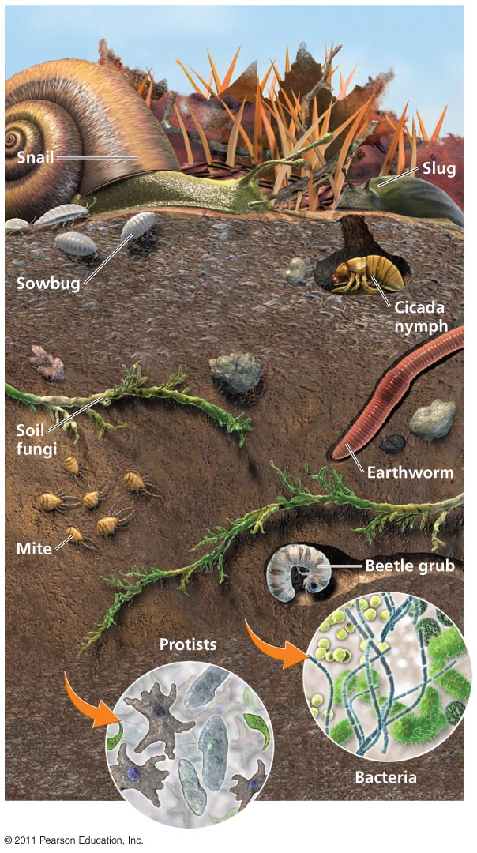
What is soil?
Often defined one of several
ways:
Utilitarian
Ecological
Pedologic

Slide 3
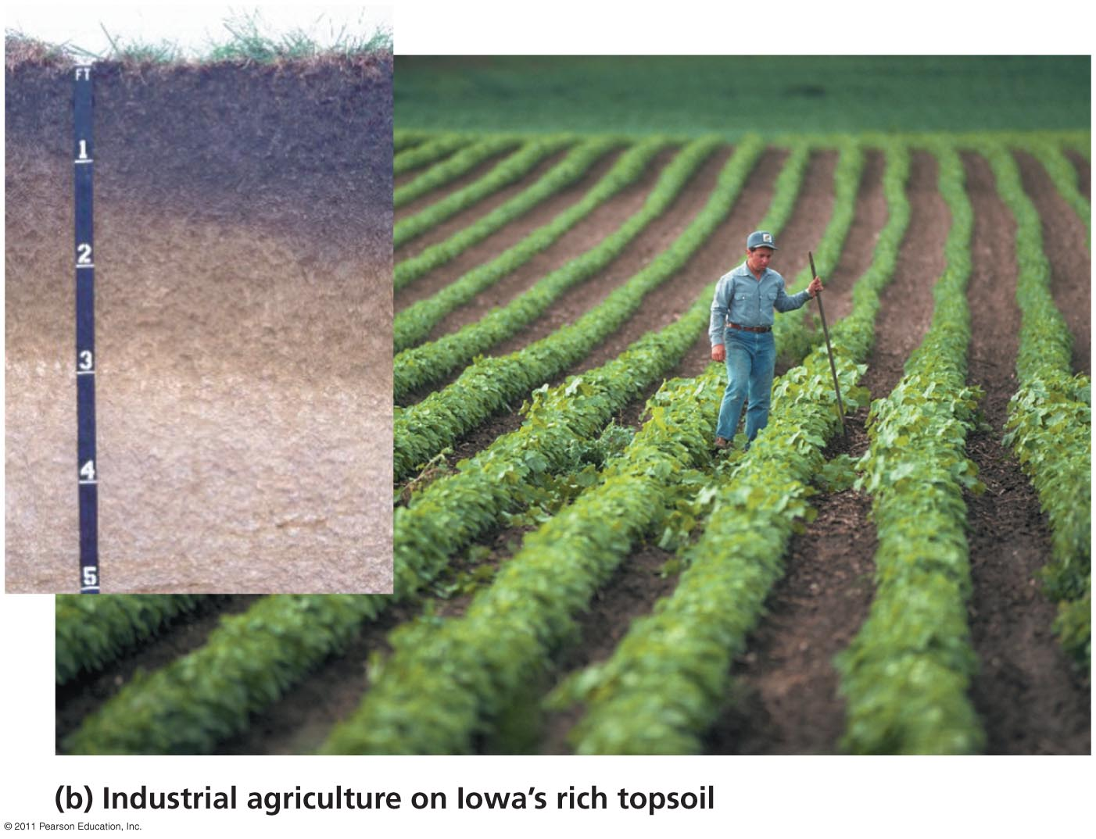
Utilitarian
defined by the properties important to agriculture, engineering, etc. (soil material)

Slide 4
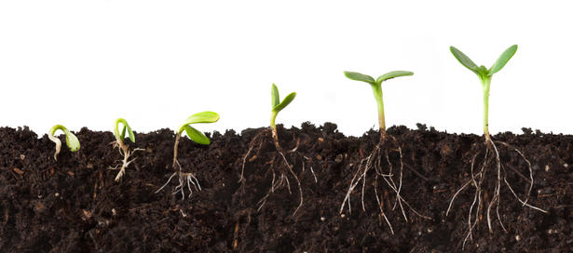
Ecological
medium capable of supporting plants both physically and through the transfer of water and nutrients (soil medium)

Slide 5
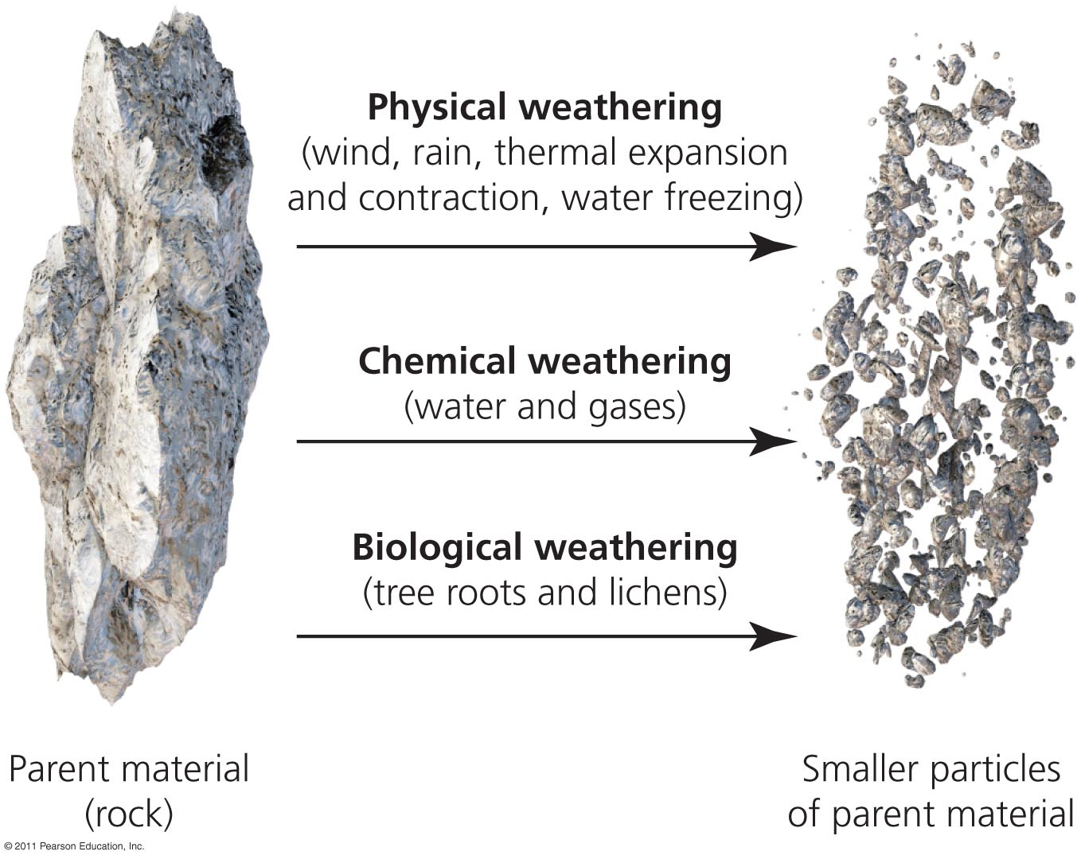
Pedologic
Formation of soil by processes such as weathering, organic matter accumulation ,and leaching (soil as a system)

Slide 6
Processes that Form Soils and Influence Soil Properties
The movement of water down through the soil profile (leaching)
Organic matter accumulation (sequesters carbon)
Mineral weathering
Mineral formation
Many Others

Slide 7
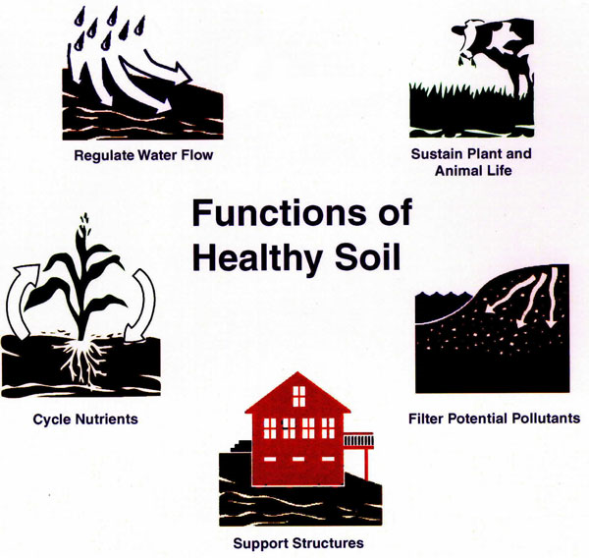
Services by the Soil System
Food
Fiber
Filtration of gas & water
Water storage
Carbon Storage

Slide 8
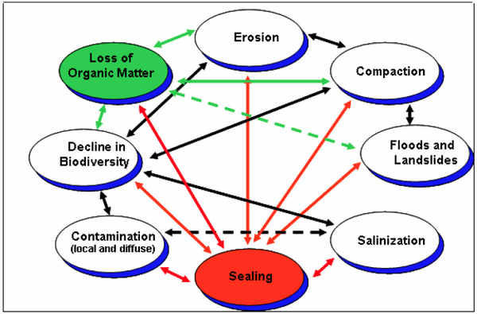
Threats to Soils Include:
Erosion
Contamination
Sealing
Compaction
Loss of biodiversity
Salinization
Floods and Landslides

Slide 9
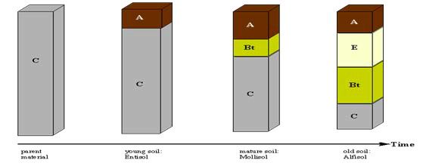
Soils are dynamic,
they change over time
Time
Parent
material
Young
soil
Mature
soil
Old
soil

Slide 10
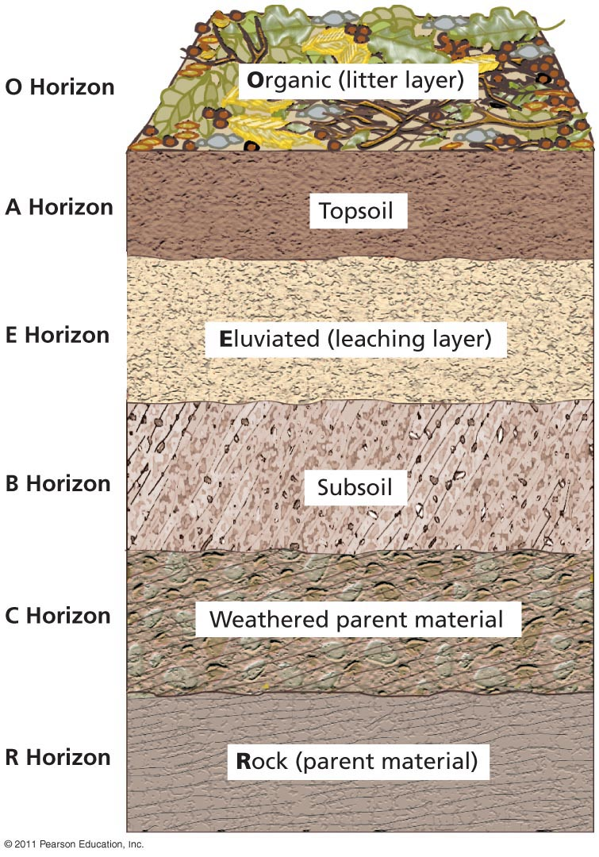
As soils age, they form distinct soil horizons and a soil profile
topsoil
subsoil
parent material

Slide 11
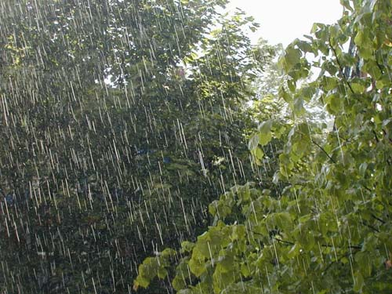
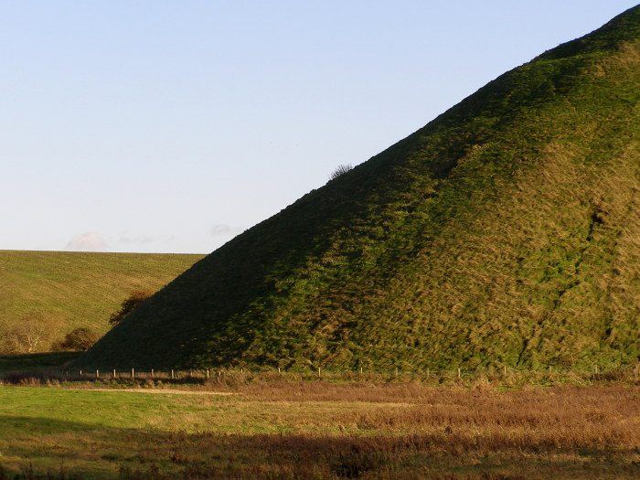
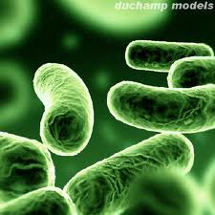
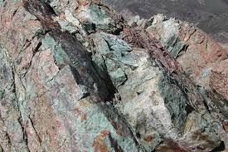
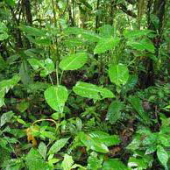
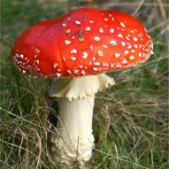
Ultimately, soils are influenced by their environment
Climate
Relief
Organisms
Humans
Bacteria
Parent material
Vegetation
Fungi

Slide 12
If you add time, then you get the soil forming factors: CLORPT
Climate
Organisms
Relief (topography- hills, mountains…)
Parent material
Time

Slide 13
The Role of Climate
The balance between moisture and temperature is particularly important to the development of soils.
MOISTURE (precipitation)
how much
when
TEMPERATURE
season length
range of highs/lows

Slide 14
Houston, TX

Slide 15
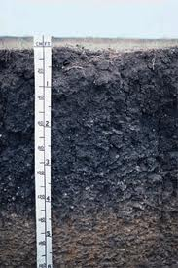
High rainfall during warm temperatures
Water used by plants
Lots of plant growth
Darker topsoil
Houston soil

Slide 16
Gainsville, AL

Slide 17
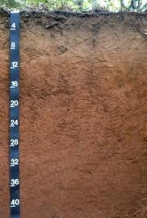
High rainfall during cooler temperatures
Few plants to use water
Excess water leaches through the soil
Red/orange subsoil
Bama soil
Notes:
Colors as a result of oxidation

Slide 18
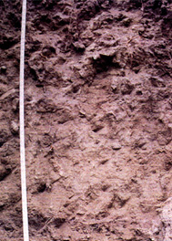
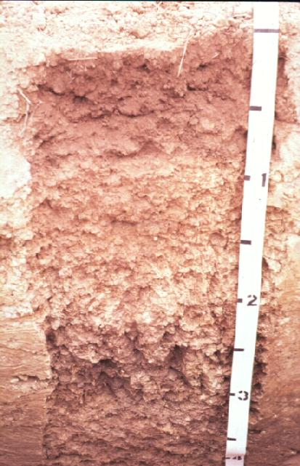
Low rainfall
Little vegetation
Little water reaches subsoil
Low plant growth
Salts accumulate
Thin, light colored topsoil
White subsoil
(Orovada soil
from Nevada)
(Casa Grande soil
From Arizona)

Slide 19
In summary
Soil profiles reflect the conditions under which they formed.
Dark topsoil:
lots of plant
material
Red subsoil:
weathering
and oxidation
Complex subsoil:
Lots of time to differentiate horizons

Slide 20
Extension slides

Slide 21
The Role of Parent Material
Material from which soil forms:
bedrock
colluviam (sediments transported via gravity to the base of a slope)
alluvium (loose, eroded soil)
loess (windblown material)
Parent material influences mineral composition and particle size of soil.
(Arizona)

Slide 22
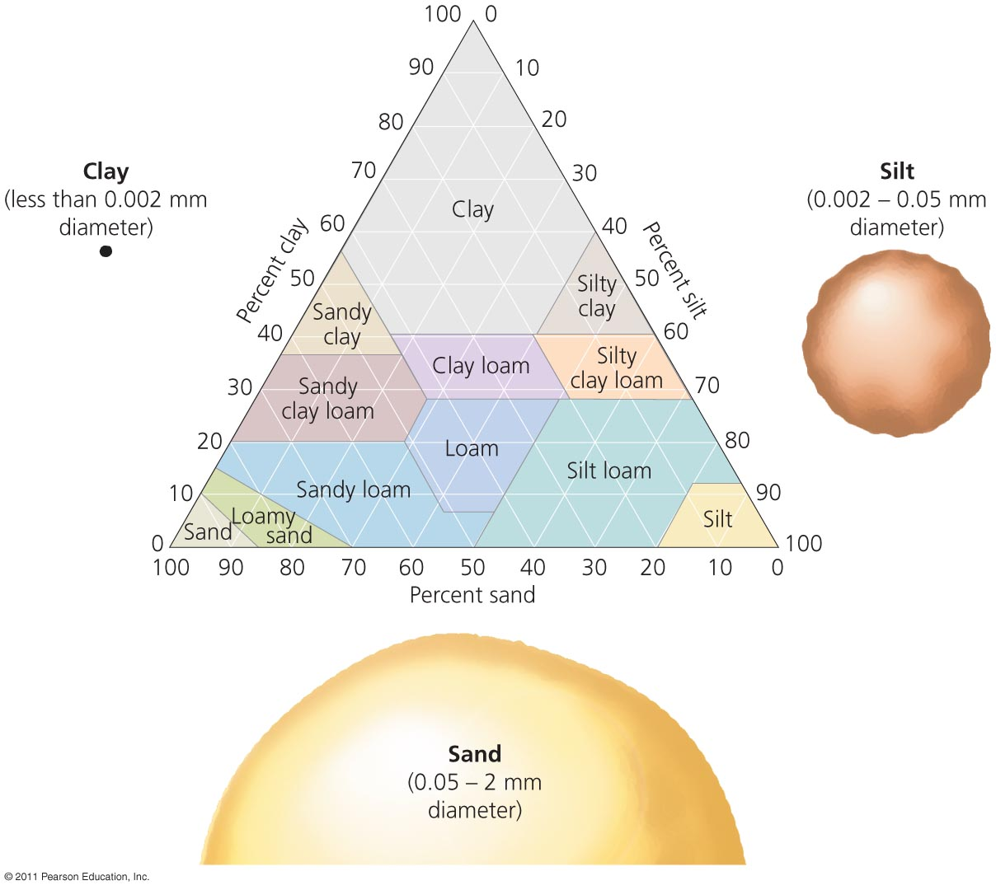
Particle size
Smaller, finer particles (like clay)
hold water and nutrients,
including carbon
Coarser particles
don’t hold water or nutrients,
but they promote oxidation
(Arizona)

Slide 23
Linking topsoil to Parent material
Coarse
Fine
Organic matter more readily decomposed
Organic matter stays in the soil
Light brown
Darker brown

Slide 24
Linking subsoil to Parent material
Coarse
Fine
Water allows weathering and chemical transport
Weathering products remain in subsoil as salts
Oxidized, red and yellow
Reduced, green and grey

